Slide 1

Preceptor Orientation for the Executive Leadership Program

Slide 2
We appreciate your agreement to precept our executive leadership students
Collaboration and leadership are important to the student learning experience
Please complete the Power Point Presentation: Clinical Preceptorship:
Shining the Light Toward the Future

Slide 3
Preceptor Information
Who is a preceptor for our program?
  A registered nurse administrator in a healthcare setting (approved by faculty)
    Master’s degree prepared
    It is preferred that the preceptor be at the next level of administration appropriate for the student’s career goals
    May not be the student’s supervisor, nor in the supervisor’s direct line of authority
    May or may not be at the student’s facility
    Willingness to provide guidance for student activities

Slide 4
Facility Restrictions
Valid clinical contract with East Tennessee State University, College of Nursing
Clinical sites must be approved by faculty

Slide 5
Clinical Expectations
Clinical course hours vary for each clinical course
Clinical health requirements must be met if the student has direct patient contact
If the practicum is out of state, the student must comply with licensure regulations of that state
The preceptor must attest student attendance on the Documentation of Clinical Hours form
Before the student begins the precepted experience, a Learning Plan must be completed and signed by preceptor, student, and faculty
The Learning Plan format is presented on the next two slides

Slide 6
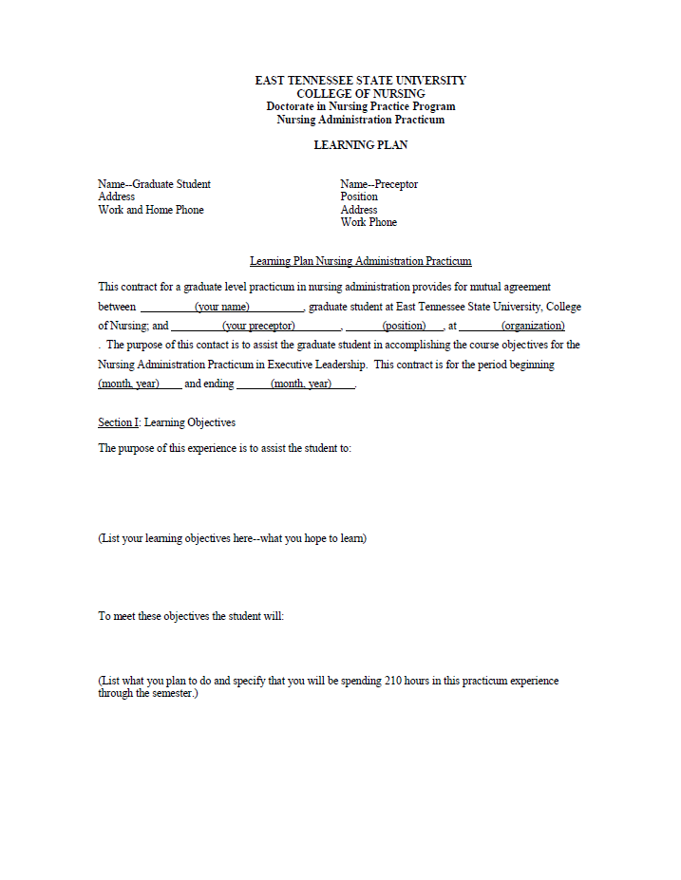

Slide 7
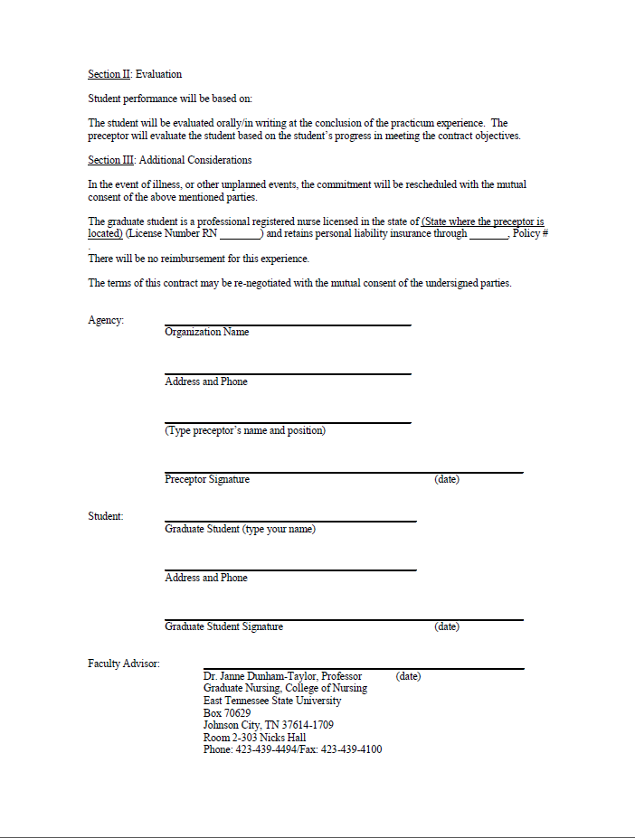

Slide 8
The following three slides outline the preceptor, faculty, and student roles

Slide 9
Preceptor Responsibilities
1. Orient student to agency.
2. Collaborate with student on development of learning plan.
3. Collaborate with student on activities to fulfill learning plan objectives.
4. Collaborate with student and faculty adviser on evaluation of clinical practicum.
5. Provide direct supervision of the student as appropriate to the clinical situation.

Slide 10
Faculty Responsibilities
1. Collaborate with preceptor and student on progress toward achievement of practicum objectives.
2. Collaborate with preceptor on appropriateness of practicum experiences.
3. Be available to preceptor and student for consultation related to clinical experiences.
4. Collaborate with preceptor and student on evaluation of clinical practicum.
5. Provide feedback to preceptor about clinical practicum.

Slide 11
Student Responsibilities
1. Provide clinical schedule to preceptor and any other required agency personnel.
2. Notify appropriate persons of any change in practicum schedule.
3. Carry out activities designed to meet objectives outlined in learning plan.
4. Follow guidelines of agency contract during clinical practicum.
5. Provide feedback to clinical preceptor.
6. Arrange schedule of evaluation meetings with preceptor and faculty.

Slide 12
Student Evaluation
At the end of the precepted experience the preceptor will complete the Preceptor Evaluation of Graduate Student Progress form on the following slide

Slide 13
Mark, the “Preceptor Evaluation of Graduate Student Progress” form goes here

Slide 14
Faculty Collaboration
Near the end of the practicum experience the student will set up an evaluation meeting or conference call with the preceptor, faculty, and student
Prior to this meeting, the preceptor must complete the Evaluation form
The preceptor’s evaluation will be discussed with the student at this meeting

Slide 15
Questions?
If you have any questions or concerns, please contact the faculty member listed on the Learning Plan

Slide 16
Preceptor Signature Form
I, __________________ have received the ETSU College of Nursing Preceptor Orientation Packet for Executive Leadership students.
Student Name _________________________
Preceptor Signature _____________________
Practice Site Name _____________________
Date ____________________

Slide 17

Thank you for taking the time to enhance student learning!

