Slide 1
Strategies to Improve and Facilitate Child and Family Health Research and Scholarship: Findings from a Regional Mixed-Methods Study
Karen Schetzina, MD, MPH, FAAP
October 25, 2024

Slide 2
Disclosure
My husband is the owner of Callion Pharma.

Slide 3
Goals
Understand barriers, opportunities, and facilitators to fostering and enhancing interprofessional child and family health research and scholarship (research, education, service, program development, and advocacy) in the region.
Utilize this information to identify new approaches to building interdisciplinary and transdisciplinary research and scholarship.
This study was reviewed and approved by the ETSU IRB.
Funded by a grant from the National Organization of Research Development.
Acknowledgements: Katie Duvall (original PI), Esther Adebayo Abikoye, Lori Moore, Meredith Jordan, Chandni Naidoo

Slide 4
Methods
Data collection: Electronic survey and 4 focus groups (one in-person and 3 virtual; recorded, transcribed, notes taken)
Population of interest: administrators, faculty, staff, trainees in institutions for higher education and community organization representatives in South Central Appalachia
Recruitment: emails and social media through the STRONG ACC (Research and Academics Subcommittee) and the ETSU Child and Family Health Institute – snowball sampling
SPSS used to calculate descriptive survey statistics. Themes and examples identified from focus groups using transcript review and ChatGPT.

Slide 5
Surveys
2023

Slide 6
Survey Participants (n=57)
Respondents were 81.5% female, 94.4% white, 87.3% ages 25-64.

Slide 7
Select the types of child and family health research and scholarship activities you engage in as part of role within your organization.
Counts/Percent:
Advocacy (30, 54.5%)
Education (38, 69.1%)
Program Development (30, 54.5%)
Quality Improvement (22, 40.0%)
Research (28, 50.9%)
Service (29, 52.7%)
Other (2, 3.6%)
Counts

Slide 8
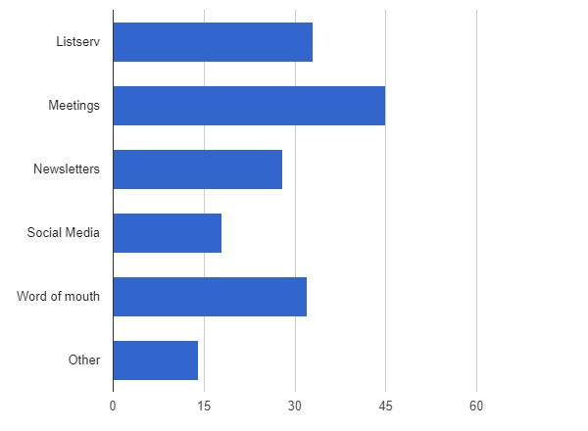
Where do you get your information about child and family health research and other forms of scholarship (ex. Quality improvement, program development/evaluation, and advocacy) being conducted in the South-Central Appalachian region?
Counts/Percent:
Listserv (33, 61.1%)
Meetings (45, 83.3%)
Newsletters (28, 51.9%)
Social Media (18, 33.3%)
Word of mouth (32, 59.3%)
Other (14, 25.9%)
Counts

Slide 9
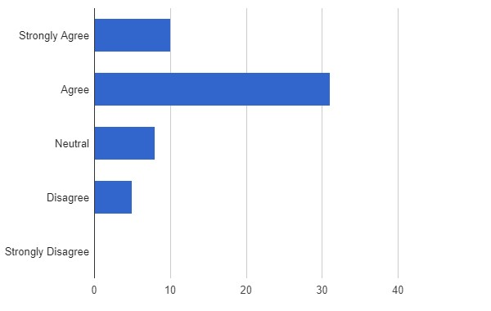
I feel connected to others that do child and family health research and other scholarship within our region.
Counts/Percent:
Strongly Agree (10, 18.5%)
Agree (31, 57.4%)
Neutral (8, 14.8%),
Disagree (5, 9.3%),
Strongly Disagree (0, 0.0%)
Counts

Slide 10
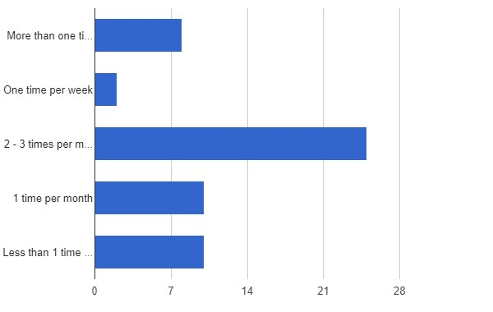
How often do you have opportunities to collaborate with others on child and family health research and other scholarship?
Counts/Percent:
More than one time per week (8, 14.5%)
One time per week (2, 3.6%)
2 - 3 times per month (25, 45.5%)
1 time per month (10, 18.2%)
Less than 1 time per month (10, 18.2%)
Counts

Slide 11
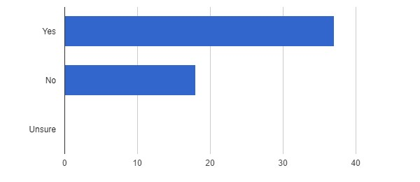
Have you ever worked with an Institutional Review Board (IRB) before to receive approvals for research and other scholarship you have worked on?
Counts/Percent:
Yes (37, 67.3%)
No (18, 32.7%)
Unsure (0, 0.0%)
Counts

Slide 12
Survey Results – Involvement in collaborative child and family health research and scholarship
Statement | % Agree or Strongly Agree
Organization supportive of their participation. | 90.3%
Have dedicated time to meet with collaborators. | 70.9%
Currently engage with other individuals and organizations on improvement. | 88.9%
61.8% reported existing barriers and suggested the following to encourage collaboration in the region:
Increasing access to child and family health data.
Creating opportunities to bring people together.
Promoting current research.

Slide 13
Focus Groups
2024

Slide 14
Focus Group Results
Higher Ed participants
8 clinical faculty
3 other faculty

Slide 15
Tell me about your experience with getting information about child and family health, research, and other forms of scholarship. So, for instance, what kinds of information have you received, used, or explored before.
Information Sources: Emails, email alerts, listservs, newsletters, professional organizations, webinars
Challenges: Information overload, identifying relevant from irrelevant data (easy to overlook - too many emails!), time constraints
Need for Practical Resources: Concise, visual, easy-to-understand summaries to use in work with families
Interactive Learning: Prefer discussion, group activities, hand-on approaches over passive or webinar participation
Collaborative Learning: Networking and learning from colleagues through collaborative efforts
Use of Technology: Google Scholar alerts, Mendeley to organize references
Importance of Applied Research: Research to directly inform practice and enhance outcome
Curiosity and Lifelong Learning: Staying informed is essential to roles

Slide 16
What sources of information would you prefer to use? And why? So, for instance, if you were able to choose a source or sources of information, which option would you recommend or prefer.
More accessible, actionable data
Need research on issues immediately relevant to communities
Need local data
Enthusiasm for engaging with new information and applying it to serve families
Brief impactful summaries that could be shared with families
Cross-institutional partnerships improve access to information
Mentorship is vital for understanding information and opportunities
Preference for interactive learning
Challenges with data usage due to permissions
Email fatigue and information overload
Setting alerts on Google Scholar

Slide 17
How you collaborate with other organizations or individuals to develop or conduct child and family health research and scholarship
Diverse collaborative partnerships described among healthcare providers, educational institutions, social work programs, government agencies, and community organizations.
Importance of relationship-building highlighted - trust and familiarity often dictate collaboration opportunities.

Slide 18
Are there barriers or competing priorities? And how do you carry out collaboration effectively, despite those?
Barriers
Approaches to overcoming
Financial limitations (esp. for non-profits)
Competing priorities and time constraints – time management – email overload
Institutional and organizational challenges – bureaucratic processes, varying organizational practices, staff turnover
Accessing information and potential collaborators
Research relevance to practice and community needs
Advocacy efforts needed
New to role or lacking academic experience
Use of digital tools for meetings and information sharing and management
Streamlined processes and clearer communication regarding resources and opportunities.
Design collaboration opportunities to result in outcomes that benefit communities served
Engaging stakeholders with policymakers can drive systemic change
Foster opportunities for networking and building on existing relationships
Mentorship is key

Slide 19
Are there are other ways to facilitate collaboration in this research and scholarship? And if so, how? What needs to be done differently?
Need leadership and organizational support for collaboration.
Dedicated resources and personnel
Facilitate introductions to potential collaborators
Provide support for engagement in joint projects (i.e. coordinate of meetings)
Tailor communications rather than mass email
Maintain centralized platforms for resources and collaboration opportunities and updates – who does what in the community
Regular forums, open meetings, and groups for collaboration (during work hours)
Collaborative brainstorming sessions to pool knowledge and develop innovative solutions
Discussion of ongoing projects
Avoid burden of formal agenda – but have meeting “themes”
Informal gatherings – potlucks or happy hours – social gatherings build connections
Study design consideration
Qualitative research to facilitate community member input
Ensure that data collected for one project could be used more broadly
Need sustainable, successful models for collaboration rather than one-time projects

Slide 20
Any final thoughts about barriers, facilitators, or opportunities or anything else to add.
Importance of -
Collaborating to support comprehensive child and family health and well-being
Understanding cultural and socioeconomic contexts of populations served and recognition of system issues requiring collaborative attention
Feedback from community partners and stakeholders in guiding and improving collaborative efforts

Slide 21
Discussion
Strengths and Limitations
Regional study
Breadth of definition of scholarship
Interdisciplinary and interprofessional collaboration
Engaged clinician faculty
Today’s results preliminary
May not be representative of entire population of interest
Results are actionable – next steps?
Thank you for joining today!

Slide 22
Contact:
Dr. Karen Schetzina
schetzin@etsu.edu

