Slide 1
Academic Structure Task Force Town Hall
October 26, 2023

Slide 2
The Task Force
David Atkins
Brian Bennett
Ginni Blackhart
Daryl Carter
Brian Cross
Nancy Dishner
Steve Ellis
Joy Fulkerson
Ronnie Gross
Lisa Haddad
Dana Harrison
TJ Jones
Jill LeRoy-Frazier
David Linville
Amal Khoury
Stephen Marshall
Arpita Nandi
Ron Roach
Megan Roberts
Dawn Rowe
Jeff Snodgrass
Alan Stevens
Ester Verhovsek
Trent White

Slide 3
Agenda
The Charge & Questions
Work To Date
Problems & Opportunities
Themes
Draft Models
Clarifying Questions
Next Steps

Slide 4
Charge
Examine the academic structure of our colleges and ensure we continue to create clear and seamless pathways toward degree completion, provide holistic support for our students, and align with the goals in our strategic plan

Slide 5
Key Questions (Part 1)
What college organizational structure would best serve our students to ensure they have a clear path from admission to graduation?
How do we build on our existing strengths in teaching, research, and service by aligning academic units and expanding capacity?
How do we avoid duplication or overlap in our offerings and reduce confusion for our students?
How do we continue to build on our reputation as a premier health sciences institution in Tennessee and develop additional signature programs or areas of study?

Slide 6
Key Questions (Part 2)
How will the organizational structure lead to greater flexibility and innovation as we continue to build on the institution’s core strengths and respond to the changing landscape across higher education?
How will a reorganized structure ensure the university uses its resources strategically to meet its goals?
How will the structure support the university’s vision and mission and facilitate achieving the goals in the current strategic plan?

Slide 7
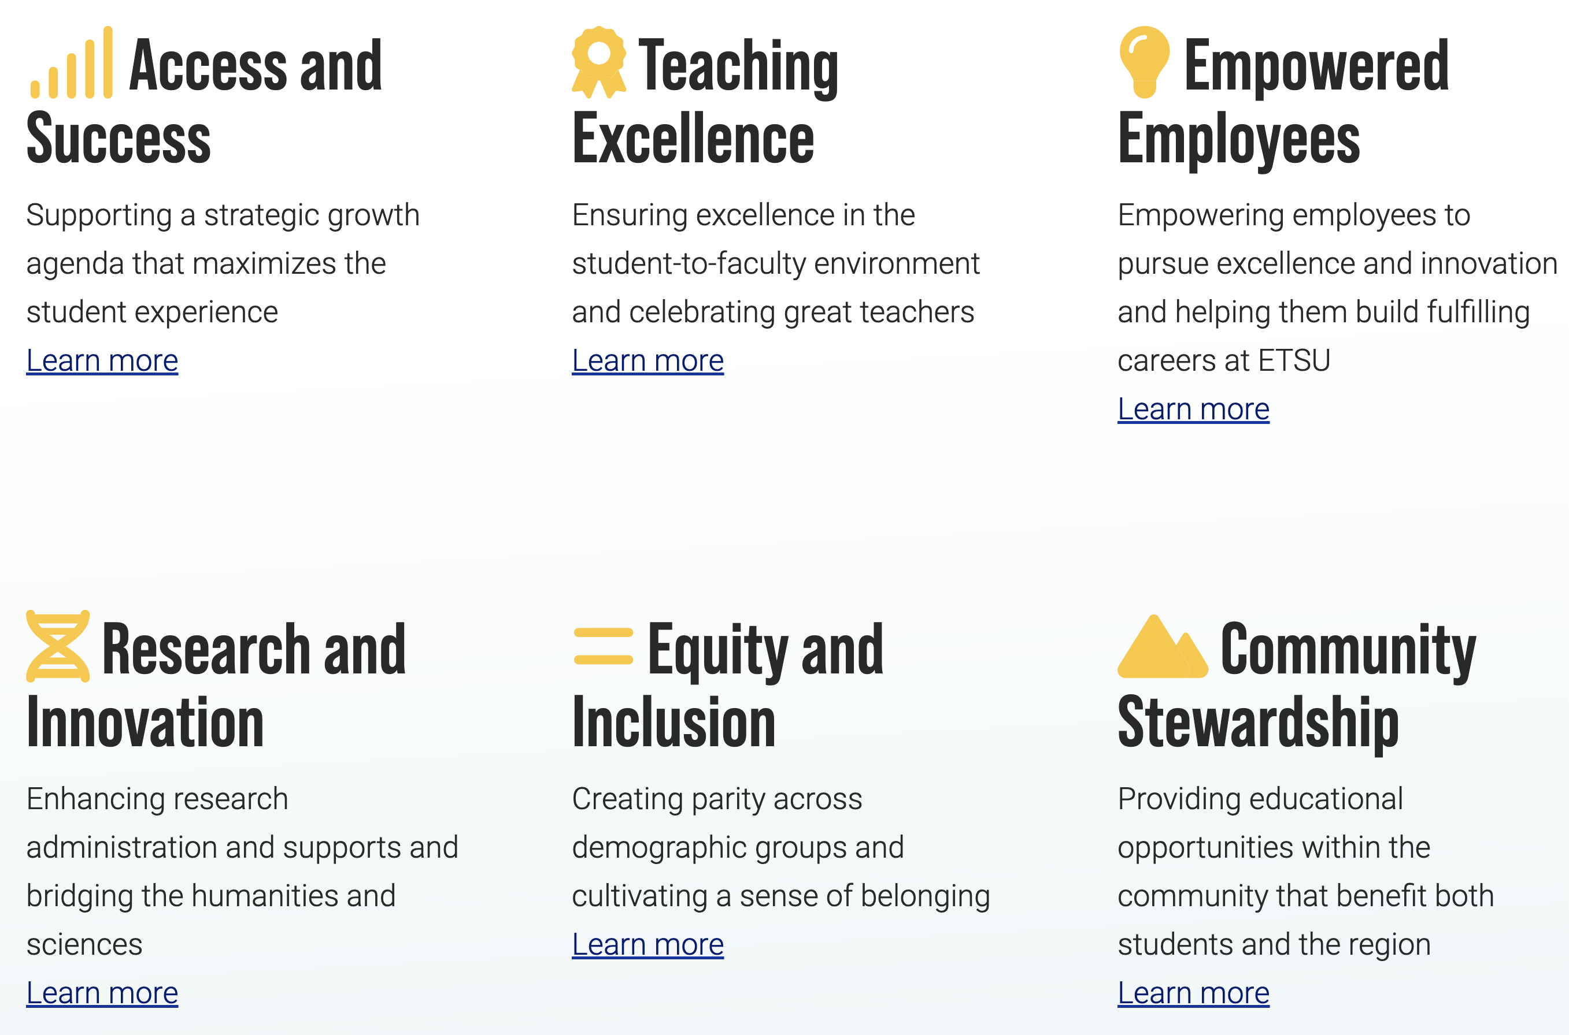
Strategic Plan Overview

Slide 8
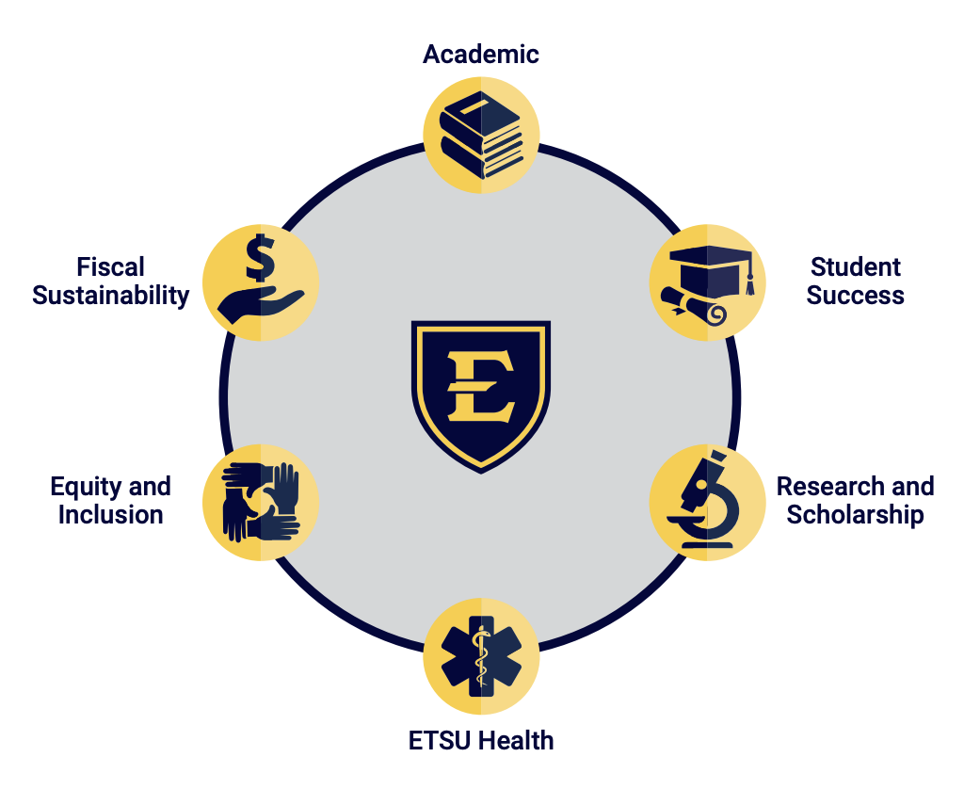
125.2 Overview

Slide 9
To Date…
Fortnightly ASTF meetings
Five teams produced seven proposed models
41 Co-Chair meetings…and counting
840 attendees
Ten comments received via website/email

Slide 10
Problems & Opportunities

Slide 11
Problems/Opportunities
Collaboration with other departments is forbidden by some chairs
Engineering – needs to be connected to sciences to grow
ETSU Health Science Center – infrastructure needs to exist or all colleges need to be schools in a college
Arts & Sciences – split to give both an identity or keep together?
Media & Communication and Digital Media need aligned
Colleges create siloes. Siloes create barriers. Minimize siloes/colleges to the extent possible.
Decentralized advising has a single point of failure

Slide 12
Problems/Opportunities
Kinesiology in Clemmer is confusing to students
Medical professions advising isn’t all encompassing in terms of pre-health
Some colleges have been impactful to a point that changing from college to school could do reputational harm – have to consider the optics and politics
Identity – colleges don’t seem to matter to students
Majoring in education (e.g., math education) is confusing - secondary ed minor​s

Slide 13
Problems/Opportunities
Computing – need to wrestle with information systems (Business) and computer science (Science) dissonance
Clemmer leaning heavily into identity of SERK and C&HS for growth
SERK – conglomeration of multiple distinct programs that are arguably best placed in more than one college
Psychology, Social Work, and Counseling & Human Services – many synergistic opportunities but in three different colleges
Centers/Institutes – inconsistent reporting structure and accountability; limited collaboration across centers and institutes
Colleges and departments (quantity and unclarity) muddy clear pathways

Slide 14
Problems/Opportunities
We don’t highlight signature programs to the extent we could
Medical professions advising is perceived to be misplaced
Transitioning from pre-health (e.g., med) to non-pre-health – we lose students
Health professions deadlines – multiple applications, scholarships
Linkage between admissions and decentralized advising is missing
Need one umbrella for student admissions into health/pre-health programs - especially for undergrads​

Slide 15
Problems/Opportunities
CCRHS is “forgotten”
We’re not good at launching students (e.g., career services)
Quillen thinks it is Quillen – it does not think it is part of ETSU – we reinforce hierarchical nature of health care
Student retention takes a backseat to recruitment; disjointed service and support after student arrival
Minors are “all over the place”
Undergrad and grad advising gaps – accelerated bachelors to masters mentioned

Slide 16
Problems/Opportunities
Colleges compete for help/services
Research is underemphasized as a differentiator
ETSU is perceived to be decentralized to a fault
University School is an underutilized lab school
Isolated infrastructure for career exploration
Technology (CBAT) is a generic term with identity issues
Grad School – there are perceived barriers, but some unit needs to do the work

Slide 17
Themes
College of Arts & Sciences – keep as is or separate?
4 of 7 models propose splitting
Health colleges – keep as is or combine two or more?
Integrate Counseling & Human Services and/or Psychology into a health college?
6 of 7 models propose combining two or more colleges
College of Business & Technology – keep as is or align technology more so with STEM programs?
4 of 7 models propose moving Eng, Eng Tech, Int Arch, Surv and/or Computing

Slide 18
Themes
Clemmer College of Education & Human Development
Leaner if SERK and C&HS aligned with other departments/colleges
7 of 7 models propose moving one or more departments to another college
Depts of Media & Communication and Digital Media
Align in one college
6 of 7 models propose alignment
University College and College of Graduate and Continuing Studies
College or administrative unit?
7 of 7 models propose changes

Slide 19
NOTE!
The ASTF has not reached consensus on the draft models to be presented
The overarching goal is to collect input that will inform refinement of draft models
Draft models are presented in no particular order
None of the draft models address the Graduate School
The status quo is on the table
We’re not done collecting information

Slide 20
Draft Model A

Slide 21
Draft Model A
Clemmer College of Education
Curriculum and Instruction
Early Childhood Education
Educational Foundations and Special
Education
Educational Leadership and Policy Analysis
University School
College of Arts and Sciences Mary B. Martin School of the Arts
Art and Design
Music
Theatre and Dance
School of Science and Engineering
Biological Sciences
Chemistry (Brewing and Distillation Studies)
Engineering, Eng Tech, Int Arch and
Surveying
Geosciences
Math and Statistics
Physics and Astronomy

Slide 22
Draft Model A
College of Arts and Sciences (cont.)
School of Communication, Culture and Society
Appalachian Studies
Black American Studies
Communication Studies and Storytelling
Criminology and Criminal Justice
History
Literature and Language
Philosophy and Humanities
Political Science, Int Aff and Pub Adm
Sociology and Anthropology
Women’s, Gender and Sexuality Studies
College of Business and Computing
Accountancy
Computing
Digital Media
Economics and Finance
Global Sport Leadership
Management, Marketing, and Supply Chain
Media and Communication
Sport and Recreation Management

Slide 23
Draft Model A
College of Health and Human Sciences
Gatton College of Pharmacy School of Nursing School of Health and Human Sciences
Allied Health
Audiology and Speech-Language Pathology
Counseling and Human Services
Kinesiology
Psychology
Rehabilitative Sciences
Social Work
Sport Performance
Sport Physiology
Sport Science
College of Public Health
As is
Quillen College of Medicine
As is

Slide 24
Draft Model A
University College
Career Services
Community-Engaged Learning
Continuing Studies
Cross-Disciplinary Studies
ETSU Online
Honors Programs
Military Science
Prestigious Awards
Study Abroad and Global Engagement
Undergraduate Research
Office of the Exec. Dir. Academic Advisement
University Advisement Center

Slide 25
Draft Model B

Slide 26
Draft Model B
Clemmer College of Education and Human Services
Counseling and Human Services
Curriculum and Instruction
Early Childhood Education
Educational Foundations and Special Education
Educational Leadership and Policy Analysis
Social Work
University School
College of Arts, Culture, and Society
Mary B. Martin School of the Arts
Art and Design
Music
Theatre and Dance

Slide 27
Draft Model B
College of Arts, Culture, and Society (cont.)
School of Communication, Culture and Society
Appalachian Studies
Black American Studies
Communication Studies and Storytelling
Criminology and Criminal Justice
Cross-Disciplinary Studies
Digital Media
History
Literature and Language
Media and Communication
Military Science
Philosophy and Humanities
Political Science, Int Aff and Pub Adm
Psychology
Sociology and Anthropology
Women’s, Gender and Sexuality Studies

Slide 28
Draft Model B
College of Business
Accountancy
Economics and Finance
Global Sport Leadership
Management, Marketing, and Supply Chain
Sport and Recreation Management
College of Health Professions and Sciences
School of Nursing
School of Public Health
School of Clinical and Sport Sciences
Allied Health
Audiology and Speech-Language Pathology
Kinesiology
Rehabilitative Sciences
Sport Performance
Sport Physiology
Sport Science

Slide 29
Draft Model B
College of Science and Engineering
Biological Sciences
Chemistry (Brewing and Distillation Studies)
Computing
Engineering, Eng Tech, Int. Arch and Surveying
Geosciences
Math and Statistics
Physics and Astronomy
Gatton College of Pharmacy
As is
Quillen College of Medicine
As is
University College
Career Services
Community-Engaged Learning
Continuing Studies
Honors Programs
Prestigious Awards
Study Abroad and Global Engagement
Undergraduate Research
Office of the Exec. Dir. Academic Advisement
University Advisement Center

Slide 30
Draft Model C

Slide 31
Draft Model C
Clemmer College of Education
Curriculum and Instruction
Early Childhood Education
Educational Foundations and Special Education
Educational Leadership and Policy Analysis
University School
College of Arts and Sciences
Mary B. Martin School of the Arts
Art and Design
Music
Theatre and Dance
School of Science and Engineering
Biological Sciences
Chemistry (Brewing and Distillation Studies)
Engineering, Eng Tech, Int Arch and Surveying
Geosciences
Math and Statistics
Physics and Astronomy

Slide 32
Draft Model C
College of Arts and Sciences (cont.)
School of Communication, Culture and Society
Appalachian Studies
Black American Studies
Communication Studies and Storytelling
Criminology and Criminal Justice
History
Literature and Language
Philosophy and Humanities
Political Science, Int Aff and Pub Adm
Sociology and Anthropology
Women’s, Gender and Sexuality Studies
College of Business and Technology
Accountancy
Computing
Digital Media
Economics and Finance
Global Sport Leadership
Management, Marketing, and Supply Chain
Media and Communication
Sport and Recreation Management

Slide 33
Draft Model C
College of ETSU Academic Health Sciences
Gatton School of Pharmacy
Quillen School of Medicine
School of Health and Human Sciences
Allied Health
Audiology and Speech-Language Pathology
Counseling and Human Services
Kinesiology
Psychology
Rehabilitative Sciences
Social Work
Sport Performance
Sport Physiology
Sport Science
School of Nursing
School of Public Health

Slide 34
Draft Model C
University College
Career Services
Community-Engaged Learning
Continuing Studies
Cross-Disciplinary Studies
ETSU Online
Honors Programs
Military Science
Prestigious Awards
Study Abroad and Global Engagement
Undergraduate Research
Office of the Exec. Dir. Academic Advisement
University Advisement Center

Slide 35
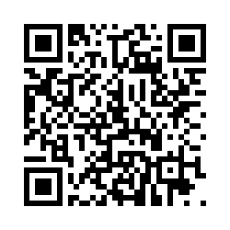
Clarifying Questions
Provide feedback via the QR code

Slide 36
Next Steps
ASTF will continue to meet – next meeting tomorrow
ASTF will continue to meet with constituents
If you’d like to chat, please reach out
foleyv@etsu.edu
hagemeier@etsu.edu
Goal is report to the Provost and President by end of calendar year
Next Town Hall in late November
Thanks for coming!

