Slide 1
How to Build a Course
Using SSASECT in INB

Slide 2
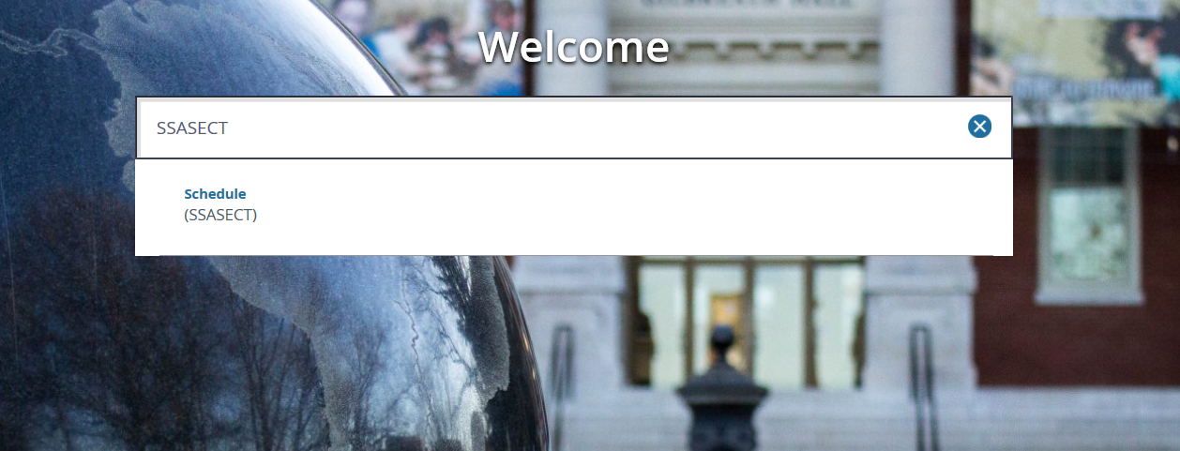
Step 1
Type SSASECT in your Banner 9 “Welcome” box.
Then press Enter or Click on “Schedule”.

Slide 3
Entering the Course Section Information:
Step 2
1. Type in the appropriate term in the term box
*For Spring- Type the year and then 10 (example: 201810)
*For Summer- Type the year and then 50 (example: 201850)
*For Fall- Type the year and then 80 (201880)
2. To add a new course, type “ADD” in the CRN box
3. Click the green “GO” button on the right hand side.

Slide 4
Entering Course Info:
Step 3
1. Subject (4 characters) - ENGL
2 Course number - 1010
3. Title - should automatically populate after tabbing.
4. Section number - See section number rubrics (Spring & Fall) (Summer)
5. Campus - 23M or Appropriate Campus Code
6. Status A - Active
7. Schedule type - Lec, Lab, L/L
(Click on drop down, it automatically populates for you. This can NOT be changed.)
Instructional Method - CON (This automatically populates but you can change it.)
8. Integration Partner - D2L (manually entered; always D2L)
9. Part of Term - See Part of Term rubric
*Be sure to hit TAB
10. Hit Save button (Bottom right)
11. Credit Hours- Course will already be assigned a credit hour, either variable or set.
*See next slide for example.
Notes:
*Note: All other boxes on the other “Course Section Information” screen will be left blank.
*You will leave “Cross List” blank. This is for the Registration Office use only.
*Note: If a course is a web-based (online) course, WEB must be entered in the instructional method box.
*Note: CRN will populate in the “CRN” box once this information is entered and saved.
*Note: Grade Mode, Session, Special Approval, Duration, and Override Duration will be left blank.

Slide 5
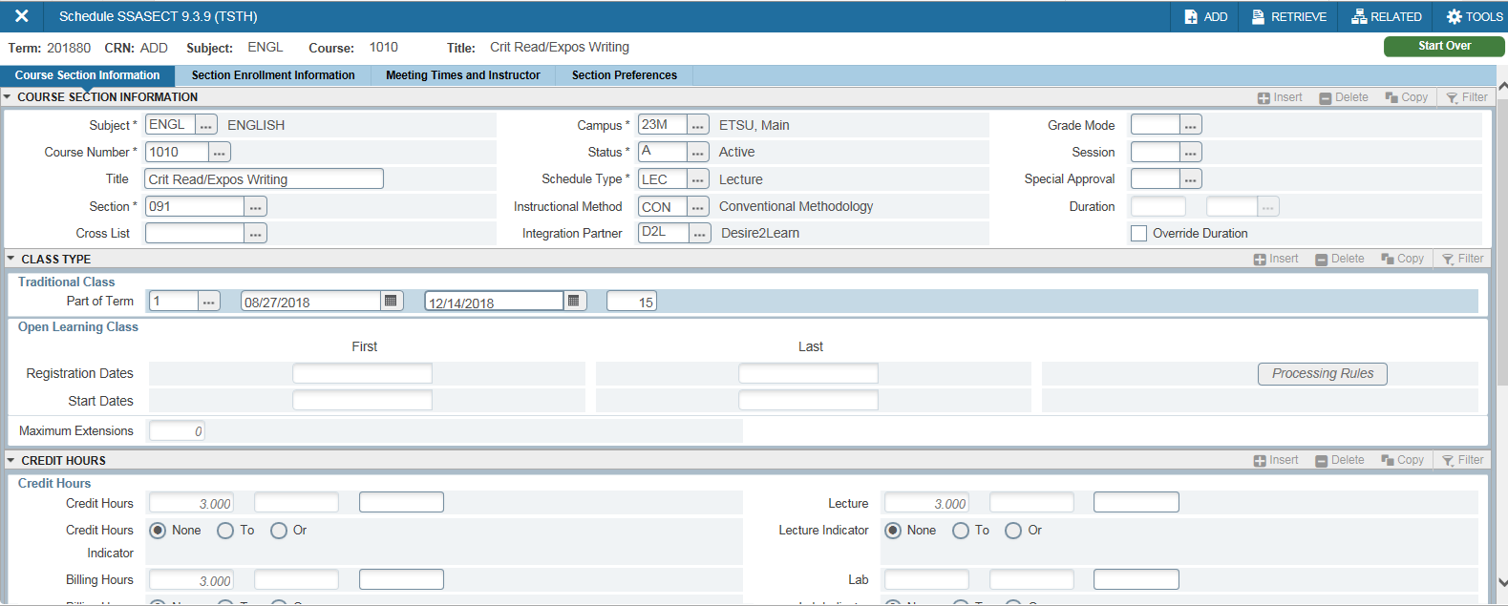
Entering Course Info Continued:

Slide 6
Variable Credit
Once a course is built, it can either be a set credit hour course or a variable credit hour course.
Courses that are variable credit courses will look like this:
When the “To” option is checked, that indicates a variable credit hour course.

Slide 7
Variable credit hour courses MUST be assigned a specific credit hour. Place the correct credit hour for the course in the blank boxes beside the “credit hours” boxes AND the “billing hour” boxes.
Once the Credit and Billing Hours have been entered, hit “save”
The blank boxes below credit and billing must BOTH BE ENTERED if the course is variable. If one is left blank, it will automatically default to the lowest credit (which could heavily impact a student’s fees/financial aid.)

Slide 8
Entering Section Enrollment:
Step 4
Next, click on the “Section Enrollment Information” tab
The only box to be filled in will be the max enrollment box.
Click Save at the bottom right.

Slide 9
Entering the Meeting Times and Instructor:
Step 5
1.. Next, click on the “Meeting Times and Instructor” tab
2. Hit the “tab” button three times and the meeting start and end dates will automatically populate along with meeting type. DO NOT alter these dates!
3. At this point, enter the days and times (must be in military time)
Click “save” (The save button is located in the bottom right hand corner)
*Note* You must click in the space below “Start Time” and “End Time” to get the text box to pop up.

Slide 10
Meeting Type
Meeting Type will automatically default to “CLAS.” During pandemic this will have to be manually updated to reflect the section number and meeting type of the course.

Slide 11
Meeting Type (Formatting)
On-ground required - At least some of the course competencies cannot be taught without some on-ground experience. The student must attend on campus, or at another designated location, for at least part of the semester. (Section number: 001-099) Meeting Type: OG1
On-ground with remote options - At least some of the course competencies are offered in an on-ground format. While the student is encouraged to take advantage of the on-ground learning opportunities, they are not essential to completing the course competencies. (Section number: 001-099) Meeting Type: OG2
Traditional Online - The course was developed specifically for online delivery. All course competencies are offered in an on-line format. The student does not need to come to campus for any of the course.
(Section number: 900-939) Meeting Type: OLA
Remote Delivery Online Synchronous - Students meet online as a class at the specific day and time noted on the class schedule. (Section number: 940-959) Meeting Type: OLS
Remote Delivery Online Asynchronous - Students complete the course online, working on their own schedule within course deadlines. The day and time will NOT appear on the schedule for asynchronous online courses.
(Section number: 900-939) Meeting Type: OLA
(NOTE: Each department will need to specify the correct Meeting Type and corresponding section numbers within Blue Cards.)

Slide 12
Entering Building and Room
Click on the “Meeting Location and Credits” tab
Enter the building code and room in the respective boxes
Online Courses will have a Building Code of “COURSE” and Room of “ONLINE”
Winter Courses will have a Building Code of “WINTER” and Room of “SESSION”
After entering this information, click “Save”
Step 6

Slide 13
Step 7
Next click on Meeting Location and Credits.
If no days and times are entered for the course, hit “save,” and the cursor will flash in the “hours per week” box. Enter the credit hour for the course in the “hours per week” box. Hit “save.” (This must be entered or it will NOT let you save).

Slide 14
Step 8
Entering the Instructor’s ID:
Hit the “next block” key or ALT+Page Down
In the ID box, enter the instructor’s E#
If E# is not known, use the drop down menu to find instructor by first and last name.
Hit “save”

Slide 15
Frequently Encountered Problems
Error: Person not an instructor
Not everything has been approved and finalized on HR’s end. We cannot override this error message.
Credit Hour needed not listed
If a course is a variable credit, it was approved through CPS with certain hours; those hours are all that can be picked.
If a course is a set credit hour, that is how it was approved through CPS and can only be built with that credit hour.
Room Conflict or Room Needed
“Blank Meeting times” for courses that are online
Grade Mode (DO NOT ENTER ON 1st TAB)
Military Time
Part of Term (no POT 1 in Summer!)
Section Number/Campus Code/Instructional Method Matching

Slide 16
Spring Course Building Timeline
(Subject to change)
Summer and Fall Course Building Timeline

Slide 17
Submitting “Blue Cards”
Course Schedule Change Form: Changing, canceling or adding a course after access has been cut off.

Slide 18
Whenever a student is enrolled in a course and a change is being made to that particular course, a blue card is required AND an administrative memo.
The following changes will require an administrative memo to be completed:
Day/time change or addition
Credit hour change
Campus code change
Part of term change
Instructional method change
***Max enrollment and building/room changes do not require a memo.

Slide 19
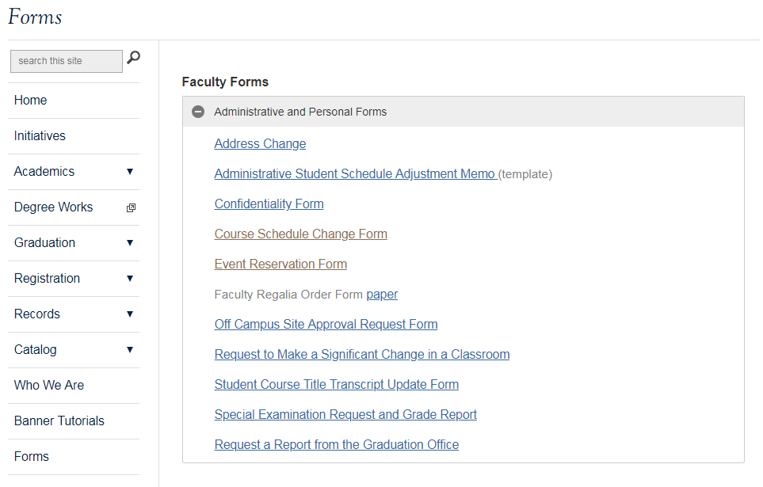

Slide 20
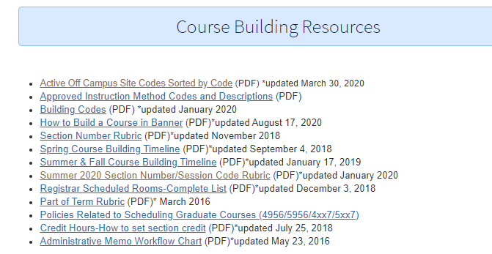
Resources https://www.etsu.edu/reg/registration/resources.php

Slide 21
Registration Staff

